Slide 1
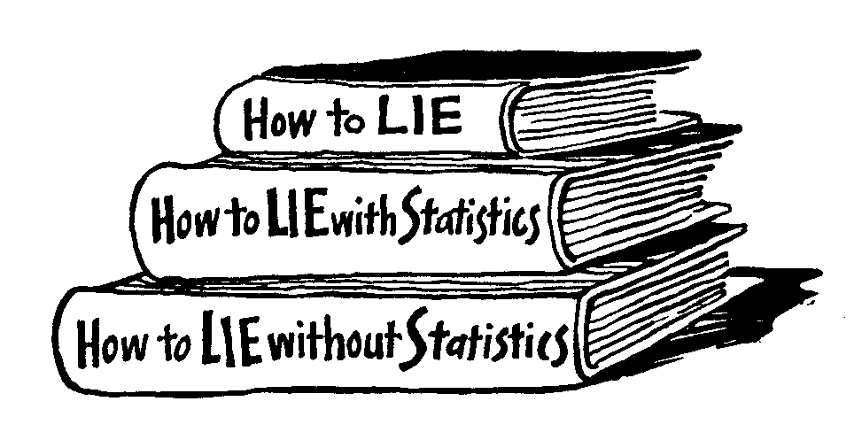
Introduction To Statistics
„There are three kinds of lies: lies, damned lies, and statistics.“ (B.Disraeli)

Slide 2
Why study statistics?
Data are everywhere
Statistical techniques are used to make many decisions that affect our lives
No matter what your career, you will make professional decisions that involve data. An understanding of statistical methods will help you make these decisions efectively

Slide 3
Applications of statistical concepts in the business world
Finance – correlation and regression, index numbers, time series analysis
Marketing – hypothesis testing, chi-square tests, nonparametric statistics
Personel – hypothesis testing, chi-square tests, nonparametric tests
Operating management – hypothesis testing, estimation, analysis of variance, time series analysis

Slide 4
Statistics
The science of collectiong, organizing, presenting, analyzing, and interpreting data to assist in making more effective decisions
Statistical analysis – used to manipulate summarize, and investigate data, so that useful decision-making information results.

Slide 5
Types of statistics
Descriptive statistics – Methods of organizing, summarizing, and presenting data in an informative way
Inferential statistics – The methods used to determine something about a population on the basis of a sample
  Population –The entire set of individuals or objects of interest or the measurements obtained from all individuals or objects of interest
  Sample – A portion, or part, of the population of interest

Slide 6
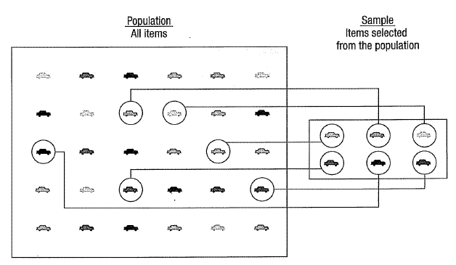

Slide 7
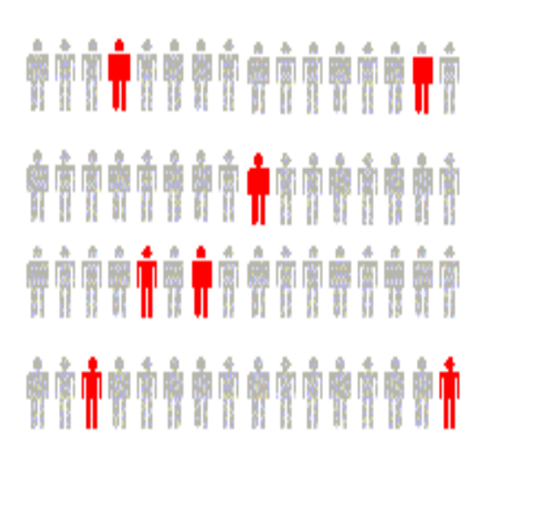
Inferential Statistics
Estimation
  e.g., Estimate the population mean weight using the sample mean weight
Hypothesis testing
  e.g., Test the claim that the population mean weight is 70 kg
Inference is the process of drawing conclusions or making decisions about a population based on sample results

Slide 8
Sampling
a sample should have the same characteristics
as the population it is representing.
Sampling can be:
with replacement: a member of the population may be chosen more than once (picking the candy from the bowl)
without replacement: a member of the population may be chosen only once (lottery ticket)

Slide 9
Sampling methods
Sampling methods can be:
random (each member of the population has an equal chance of being selected)
nonrandom
The actual process of sampling causes sampling
errors. For example, the sample may not be large
enough or representative of the population. Factors not
related to the sampling process cause nonsampling
errors. A defective counting device can cause a
nonsampling error.

Slide 10
Random sampling methods
simple random sample (each sample of the same size has an equal chance of being selected)
stratified sample (divide the population into groups called strata and then take a sample from each stratum)
cluster sample (divide the population into strata and then randomly select some of the strata. All the members from these strata are in the cluster sample.)
systematic sample (randomly select a starting point and take every n-th piece of data from a listing of the population)

Slide 11

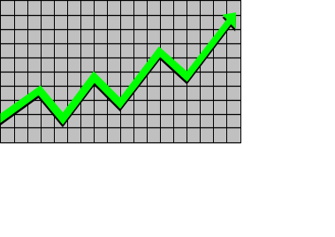
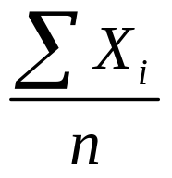
Descriptive Statistics
Collect data
  e.g., Survey
Present data
  e.g., Tables and graphs
Summarize data
  e.g., Sample mean =

Slide 12
Statistical data
The collection of data that are relevant to the problem being studied is commonly the most difficult, expensive, and time-consuming part of the entire research project.
Statistical data are usually obtained by counting or measuring items.
  Primary data are collected specifically for the analysis desired
  Secondary data have already been compiled and are available for statistical analysis
A variable is an item of interest that can take on many different numerical values.
A constant has a fixed numerical value.

Slide 13
Data
Statistical data are usually obtained by counting or measuring items. Most data can be put into the following categories:
Qualitative - data are measurements that each fail into one of several categories. (hair color, ethnic groups and other attributes of the population)
quantitative - data are observations that are measured on a numerical scale (distance traveled to college, number of children in a family, etc.)

Slide 14
Qualitative data
Qualitative data are generally described by words or
letters. They are not as widely used as quantitative data
because many numerical techniques do not apply to the
qualitative data. For example, it does not make sense to
find an average hair color or blood type.
Qualitative data can be separated into two subgroups:
dichotomic (if it takes the form of a word with two options (gender - male or female)
polynomic (if it takes the form of a word with more than two options (education - primary school, secondary school and university).

Slide 15
Quantitative data
Quantitative data are always numbers and are the
result of counting or measuring attributes of a population.
Quantitative data can be separated into two
subgroups:
discrete (if it is the result of counting (the number of students of a given ethnic group in a class, the number of books on a shelf, ...)
continuous (if it is the result of measuring (distance traveled, weight of luggage, …)

Slide 16
Types of variables
Variables
Qualitative
Quantitative
Dichotomic
Polynomic
Discrete
Continuous
Gender, marital status
Brand of Pc, hair color
Children in family, Strokes on a golf hole
Amount of income tax paid, weight of a student

Slide 17
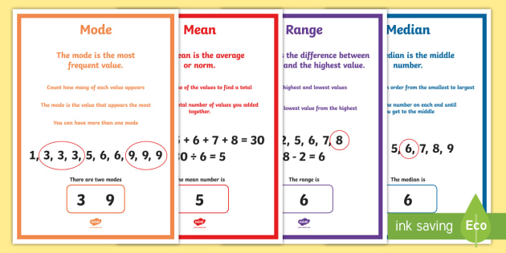
Mean, Median, Mode, Range

Slide 18
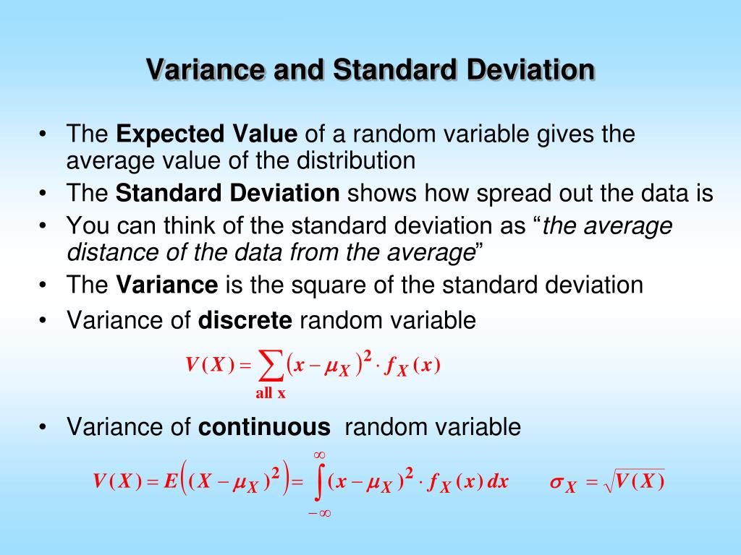

Slide 19
Numerical scale of measurement:
Nominal – consist of categories in each of which the number of respective observations is recorded. The categories are in no logical order and have no particular relationship. The categories are said to be mutually exclusive since an individual, object, or measurement can be included in only one of them.
Ordinal – contain more information. Consists of distinct categories in which order is implied. Values in one category are larger or smaller than values in other categories (e.g. rating-excelent, good, fair, poor)
Interval – is a set of numerical measurements in which the distance between numbers is of a known, sonstant size.
Ratio – consists of numerical measurements where the distance between numbers is of a known, constant size, in addition, there is a nonarbitrary zero point.

Slide 20
Numerical presentation of qualitative data
pivot table (qualitative dichotomic statistical attributes)
contingency table (qualitative statistical attributes from which at least one of them is polynomic)
You should know how to convert absolute
values to relative ones (%).

Slide 21
Frequency distributions – numerical presentation of quantitative data
Frequency distribution – shows the frequency, or number of occurences, in each of several categories. Frequency distributions are used to summarize large volumes of data values.
When the raw data are measured on a qunatitative scale, either interval or ration, categories or classes must be designed for the data values before a frequency distribution can be formulated.

Slide 22
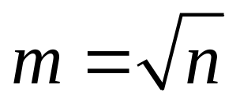
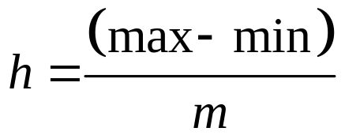
Steps for constructing a frequency distribution
Determine the number of classes
Determine the size of each class
Determine the starting point for the first class
Tally the number of values that occur in each class
Prepare a table of the distribution using actual counts and/ or percentages (relative frequencies)

Slide 23
Frequency table
absolute frequency “n_{i}” (Data Tab→Data Analysis→Histogram)
relative frequency “f_{i}”
Cumulative frequency distribution shows the total number of occurrences that lie above or below certain key values.
cumulative frequency “N_{i}”
cumulative relative frequency “F_{i}”

Slide 24
Charts and graphs
Frequency distributions are good ways to present the essential aspects of data collections in concise and understable terms
Pictures are always more effective in displaying large data collections

Slide 25
Histogram
Frequently used to graphically present interval and ratio data
Is often used for interval and ratio data
The adjacent bars indicate that a numerical range is being summarized by indicating the frequencies in arbitrarily chosen classes

Slide 26
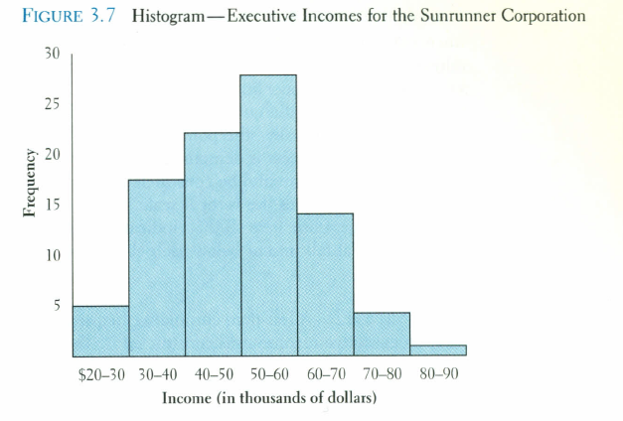

Slide 27
Frequency polygon
Another common method for graphically presenting interval and ratio data
To construct a frequency polygon mark the frequencies on the vertical axis and the values of the variable being measured on the horizontal axis, as with the histogram.
If the purpose of presenting is comparation with other distributions, the frequency polygon provides a good summary of the data

Slide 28
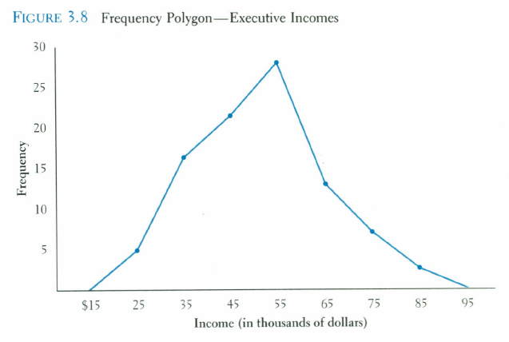

Slide 29
Ogive
A graph of a cumulative frequency distribution
Ogive is used when one wants to determine how many observations lie above or below a certain value in a distribution.
First cumulative frequency distribution is constructed
Cumulative frequencies are plotted at the upper class limit of each category
Ogive can also be constructed for a relative frequency distribution.

Slide 30
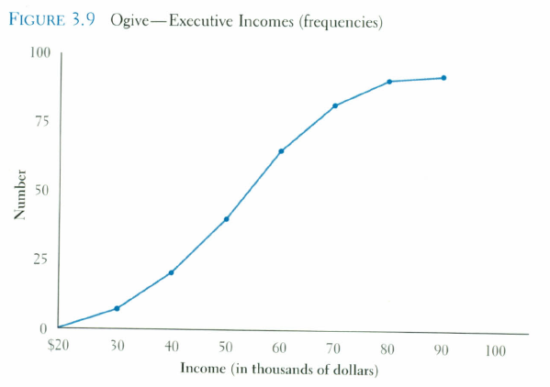

Slide 31
Pie Chart
The pie chart is an effective way of displaying the percentage breakdown of data by category.
Useful if the relative sizes of the data components are to be emphasized
Pie charts also provide an effective way of presenting ratio- or interval-scaled data after they have been organized into categories

Slide 32
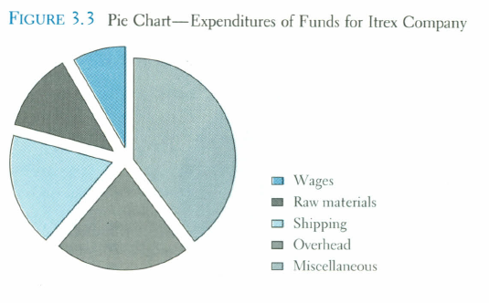
Pie Chart

Slide 33
Bar chart
Another common method for graphically presenting nominal and ordinal scaled data
One bar is used to represent the frequency for each category
The bars are usually positioned vertically with their bases located on the horizontal axis of the graph
The bars are separated, and this is why such a graph is frequently used for nominal and ordinal data – the separation emphasize the plotting of frequencies for distinct categories

Slide 34
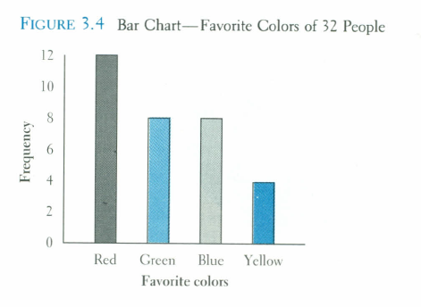

Slide 35
Time Series Graph
The time series graph is a graph of data that have been measured over time.
The horizontal axis of this graph represents time periods and the vertical axis shows the numerical values corresponding to these time periods

Slide 36
